Slide 1


LIONS DISTRICT 2-E2
OFFICER TRAINING
President and first Vice President
2024 – 2025
2nd vice dg Mike lueckenhoff

Slide 2

President's responsibilities
The Club President is the chief executive officer of the club. They preside over meetings and call the club to action to fulfill its program of service; coordinating the efforts of board members and chairpersons to implement activities of the club in both fellowship and service.
Become familiar with your Club Constitution & Bylaws
Plan and conduct meetings
Appoint committee chairpersons
Actively participate in zone meetings (District Governor’s Advisory Committee)
Managing club elections and leadership succession
CREATE YOUR LIONS ACCOUNT!
https://myapps.lionsclubs.org
Self explanatory on this website!

Slide 3
Vice president’s responsibilities
Prepare to Lead as Club First Vice President; Prepare to Succeed as Club President
As Club Vice President it is important to understand the role of the Club President and all its responsibilities:
  Stand ready to fulfill the duties of Club President if the President is unable to or is unavailable
  Be ready to fulfill other duties as assigned by the President
  Lead one or more committees during the year
  Serve as Nominating Committee Chair for Club Board of Director elections
  Dedicate time preparing to serve as Club President
Lions District 2-E2 Pres/VP Training - LCI E-Book
3

Slide 4
Club Board of Directors
President
Vice President (may be more than one)
Immediate Past President
Club Secretary
Club Treasurer
Club Membership Chair
Club Service Chair
Club Marketing Chair
Lion Tamer (optional)
Lion Tail Twister (optional)
LCIF Club Coordinator
Leo Advisor
Vice President (may be more than one)
Club Branch Liaison (if club has a club branch)
Each board member fills a specific leadership role. Understanding the roles and responsibilities of each member of your Board ensures that no officer is burdened beyond their capability to succeed.
You work in cooperation with your Board of Directors and have shared responsibilities
You have limited power (no absolute authority) and your authority to act comes from directives from the Board of Directors, Club members and the Club’s constitution and bylaws.
To be a successful President you need to empower your leadership team and Board of Directors
Lions District 2-E2 Pres/VP Training - LCI E-Book
4

Slide 5


LEAD YOUR CLUB FORWARD
As Club President & Vice President, one of your most important tasks is to lead your club forward into the future and explore yet unrealized potential of your Club.
There are several tools available:
Club Quality Initiative – Great starting point for a review of previous accomplishments and future planning.
Your Club, Your Way! – Offers ideas for ways your club can customize your meetings for an enjoyable membership experience.
These tools are available on the LCI website “Resources” – downloadable, printable!
Lions District 2-E2 Pres/VP Training - LCI E-Book
5

Slide 6

Have fun!
Make your meetings, service projects, and fundraisers FUN!
Put your Tail Twister in charge of FUN!
When people have fun, it can lead to a variety of positive outcomes including:
  Boosts Emotional Well-Being: Fun activities can help increase happiness.
  Stronger Social Connections: Sharing enjoyable experiences can strengthen relationships and create lasting memories.
  Enhances Creativity and Problem-Solving: Engaging in fun activities can foster creativity
Lions District 2-E2 Pres/VP Training - LCI E-Book
6

Slide 7
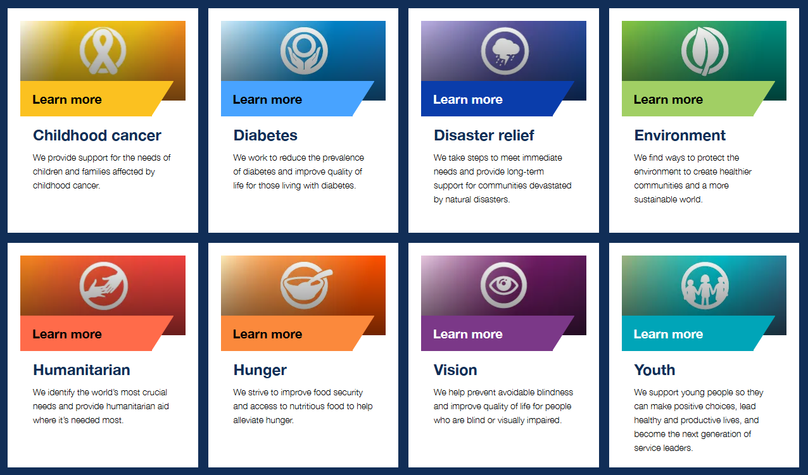
Service to your community
2024-2025 Fabrício Oliveira’s Presidential Theme
MAKE YOUR MARK
“Everywhere we serve, every time we give, we bring kindness and compassion, change and hope”
What is you club’s Service Plan & Goals?
How are you and your Board going to lead your Club in accomplishing your Service Plan & Goals?
Lions District 2-E2 Pres/VP Training - LCI E-Book
7

Slide 8

First 30 days
Attend Club Officer Training offered by your District
Schedule Club Meetings for the Year – Club and Board Meetings, Service Activities, Fundraisers, Committee Meetings, etc.
Know what Zone your Club is in and contact your Zone Chair
Work with incoming officers to complete a Strategic Plan and a Service Plan for your Club
Lions District 2-E2 Pres/VP Training - LCI E-Book
8

Slide 9
District 2-e2 zones
ZONES | CLUBS
1 - Lion Robert Duckworth | Denison, Gainesville, Sherman Evening, Sherman Noon and Whitesboro
2 – PCC Suzi Schneider | Denton, Denton Hi-Noon, Denton Triangle, Krum and Sanger
3 – Lion Rebeka Ecker | McKinney, McKinney Morning Pride, Princeton and The Colony
4 – Lion Mike Plumlee | Azle, Bridgeport, Decatur, Northwest Tarrant, Saginaw, River Oaks and Springtown
5 – Lion Susan Curry Langston | Flower Mound Irving Indian Centennial, Flower Mound New Century, Denton Robson Ranch, Highland Village, and Argyle
6 – Lion Deb Cashen | Colleyville, Grapevine, Keller, Mid Cities Family, Northeast Richland, Northeast Tarrant, Southlake Centennial
7 – Lion Matt Holmes | Fort Worth Forest Hill, Fort Worth Handley Meadowbrook, Fort Worth Riverside, Fort Worth Founders, Greater Arlington, Mansfield and Pantego
8 – Lion Sean Bryan | Alvarado, Cleburne, Glen Rose, Godley, Granbury, and Grandview
9 – Lion Jim Christen | Aledo, Burleson, Crowley, Everman, Benbrook, Weatherford Evening, Weatherford Noon
Lions District 2-E2 Pres/VP Training - LCI E-Book
9

Slide 10


Keep your club in good standing
It is important for every club leader to understand the obligations of a club charted with the association.
A club in Good Standing is one:
Which is not in “status quo or financial suspension”;
Which operates in accordance with the provisions of the International Constitution and By-Laws and International Board Policy;
Which has:
  District (Single, Sub-and Multiple) dues and fees paid in full; and
  No unpaid balance of International dues and fees greater than U.S.$10, outstanding more than thirty (30) days; and
  No unpaid Lions Club International account balance greater than U.S.$50, outstanding more than ninety (90) days.
Lions District 2-E2 Pres/VP Training - LCI E-Book
10

Slide 11

Your global action team
Your 2024-25 GAT/Support Team
DG Deb Lewis
1st VDG Michelle Greco
2nd VDG Mike Lueckenhoff
IPDG Woody Mathews
Cabinet Secretary Karri Hayford
Cabinet Treasurer Don Noblit
GMA PDG Stan Hall
GMT PDG Mary Alice Layland
GLT Deb Cashen (also Communications Director)
GST Deborah Cottle
GET PDG Vince Rosen
Zone Chairs (9)
ACRONYMS TO KNOW!
DG – District Governor
1st VDG – First Vice District Governor
2nd VDG – Second Vice District Governor
IPDG – Immediate Past District Governor
PDG – Past District Governor
PID – Past International Director
GMA – Global Membership Approach
GMT – Global Management Team
GLT – Global Leadership Team
GST – Global Service Team
GET – Global Extension Team
Lions District 2-E2 Pres/VP Training - LCI E-Book
11

Slide 12

Recognizing and celebrating success
Club Excellence Award
Office Installation Ceremony
Chevron Award Program
Membership Key Awards
Zone and Region Awards
Grassroots Lion
Humanitarian Award Winners
Presidential Awards Initiatives
Young Leaders in Service
District Team Excellence
And ----- Many, Many More
Everyone appreciates recognition
for their contributions!
A comprehensive guide and links to awards: https://www.lionsclubs.org/en/search-results?keys=awards
Lions District 2-E2 Pres/VP Training - LCI E-Book
12

Slide 13
THANK YOU!
clcmlueckenhoff@gmail.com

